Slide 1

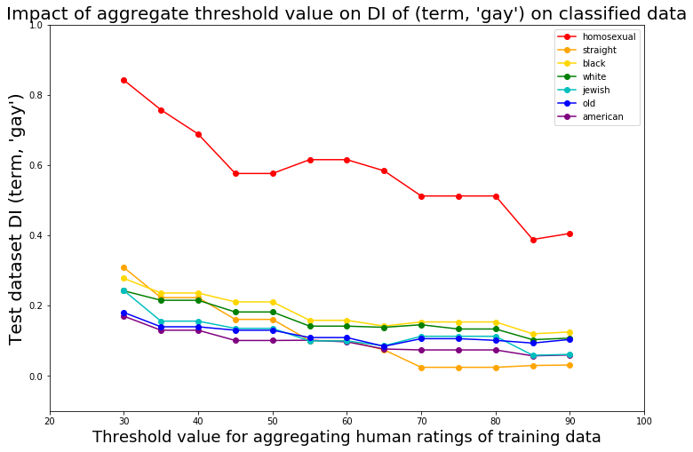
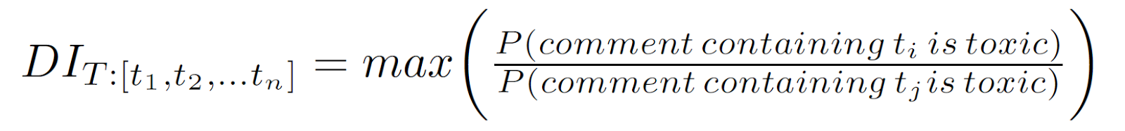
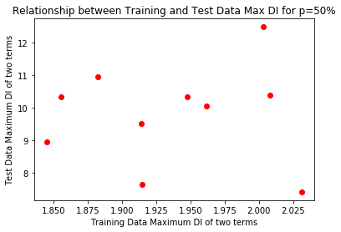
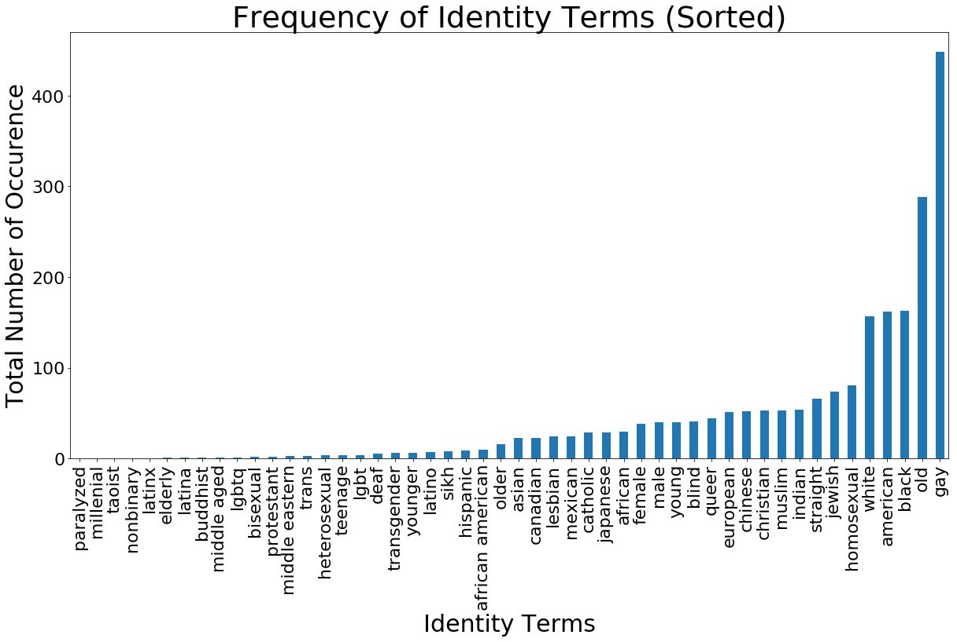
WHEN THE TRUTH IS NOT TRUE
A Study of Perturbations on “True” Toxicity in Text Classification
Neha Gupta, Yujing Ke, Neil Pruthi, Brandon Fain, Ashwin Machanavajjhala
Motivation
Posting comments online is easy, but ensuring the content is “healthy” is difficult. Negative online behavior can drive away and upset users. Websites may want to deploy a classifier to automatically flag comments that are mean, hateful, prejudiced, offense, or some combination thereof.
However, a classifier may exhibit bias and lead to unfairness because it may predict, correctly or incorrectly, a toxic label for comments about a particular demographic group more often than comments about other demographic groups. This can stem from biased input data, because the definition of a toxic comment is a subjective opinion. We are interested in how different levels of dataset bias affect the bias of a classifier trained on that dataset for text classification, a context where crowdsourced data makes it difficult to discern ground truth.
Method (continued)
Random Variations in Toxicity of Training Data
To introduce noise into the training data, we randomly select some p% of comments, and for those comments, we assign a random toxicity value of either [0,1], where 1 indicates that a comment is toxic.
Our metric for biased data is based on a generalized disparate impact for a large number of identities. Intuitively, a high disparate impact value means comments containing term t₁ are more likely to be labeled as toxic than comments containing a term t₂. We compute disparate impact for all pairs of terms and compute our disparate impact as:
The figure below looks at DI values for the test data compared to predicted values computed on training data.
Variation in Cautiousness of Toxicity Definition
The original crowdsourced dataset provides ratings for each comment by each human rater, where at least 10 human raters provided a binary rating for each comment [2]. [1] labels a comment as toxic in the training dataset when the mean binary rating across raters is greater than 0.5. We adjust this threshold and observe changes in the disparate impact.
Intuitively, a low threshold errs on the side of caution, and labels something as toxic if even few of the human raters rate it as toxic. Therefore, it has more comments labelled as toxic in the dataset,
We compare each demographic identity term to the term ‘gay’, as shown in the following figure. We choose to use the term ‘gay’ as it occurs most frequently, and is used as a metric in [1].
For the majority of terms, as threshold increased, DI (term,’gay’) decreased for both the training data and the test datasets. In the next figure, we display the test dataset’s DI for each term at each threshold, to display how much change there is between bias of the two terms before and after training a classifier.
Method
We use a dataset of roughly 100,000 human-labelled Wikipedia Talk Page comments.
Our data is split into a training dataset containing approximately 96,000 comments, and a test dataset containing approximately 33,000 comments. We used a logistic regression classifier to predict a binary value for toxicity on the test dataset.
In order to ensure we have sufficient sample sizes for each identity term, we only show results for demographic identity terms that appear in at least 3% of comments containing identity terms. The figure below shows the identity terms, in set T, that met our threshold.
Results
This data illustrates how text classifiers introduce biases between demographic groups, even when training data has randomly minimized bias, and that this bias can be either exacerbated or minimized when varying human rater consensus.
The graph showing the relationship between training and test DI shows that regardless of the percentage of noise introduced to the dataset, the disparate impact of the test data is unaffected by a range of training data disparate impacts. The bias of predicted values seems unaffected by random noise introduced in training data.
The results of the threshold graph shows that when we decrease how cautious a definition of toxicity is by increasing the threshold, after building a classifier on it, the probability that terms are predicted to be similarly toxic to ‘gay’ as tends to decrease.
Further Work
We hope to see whether additional fairness metrics such as Equality of Opportunity and Predictive Parity have a relationship between varied training data
We hope to look into a relationship between selection of demographics of the human raters and the resulting disparate impact of various identity pairings
[ Rudinger, Rachel, Chandler May, and Benjamin Van Durme. "Social bias in elicited natural language inferences." Proceedings of the First ACL Workshop on Ethics in Natural Language Processing. 2017.
Bolukbasi, Tolga, et al. "Man is to computer programmer as woman is to homemaker? debiasing word embeddings." Advances in Neural Information Processing Systems. 2016.
Hardt, Moritz, Eric Price, and Nati Srebro. "Equality of opportunity in supervised learning." Advances in neural information processing systems. 2016.
Kusner, Matt J et al. “Counterfactual Fairness.” available at http://papers.nips.cc/paper/6995-counterfactual-fairness.pdf (accessed 26 Nov 2018). 2018]
References
Dixon, Lucas, et al. "Measuring and mitigating unintended bias in text classification." available at: www.aies-conference. com/wp-content/papers/main/AIES_2018_paper_9. pdf 2018.
Wulczyn, Ellery, Nithum Thain, and Lucas Dixon. "Ex machina: Personal attacks seen at scale." Proceedings of the 26th International Conference on World Wide Web. International World Wide Web Conferences Steering Committee, 2017.
Department of Computer Science Duke University
cs.duke.edu
Mauris orci mi, varius id diam id, egestas auctor enim.

